Slide 1
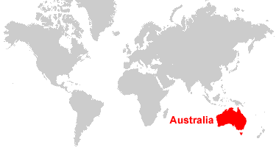

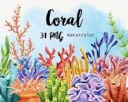
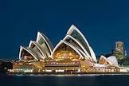
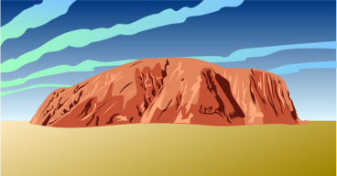
Australia

Slide 2
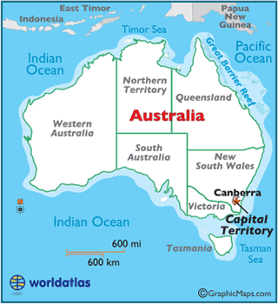
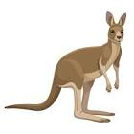


Slide 3
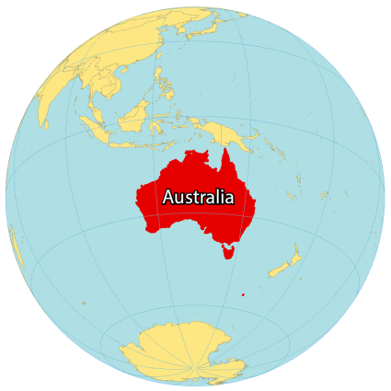
SS6G11 Locate selected features of Australia.
a. Locate on a world and regional political-physical map:
the Great Barrier Reef, Coral Sea, Uluru/Ayers Rock, Indian and Pacific Oceans, Great Dividing Range, and Great Victoria Desert.
SS6G12 Explain the impact of location, climate, distribution of natural resources, and population distribution on Australia.
a. Describe how Australia’s location, climate, and natural resources impact trade and affect where people live.

Slide 4
SS6H4
Explain the impact of English colonization on current Aboriginal basic rights, health, literacy, and language.

Slide 5
Monday, October 17
Standard: SS6G11 Locate selected features of Australia.
a. Locate on a world and regional political-physical map:
the Great Barrier Reef, Coral Sea, Uluru/Ayers Rock, Indian and Pacific Oceans, Great Dividing Range, and Great Victoria Desert.
Learning Target: I can locate Australia on a world map/globe and locate seven physical features of Australia.
Warm-up: Australia Map
Work Session: Introduce Brain Wrinkles Slides and Notes. Textbook Ch.11 Section 2 (A Brief History of Australia). Create Powerpoint Study Guide.
Closing: Think-pair- Share
Reminders:

Slide 6
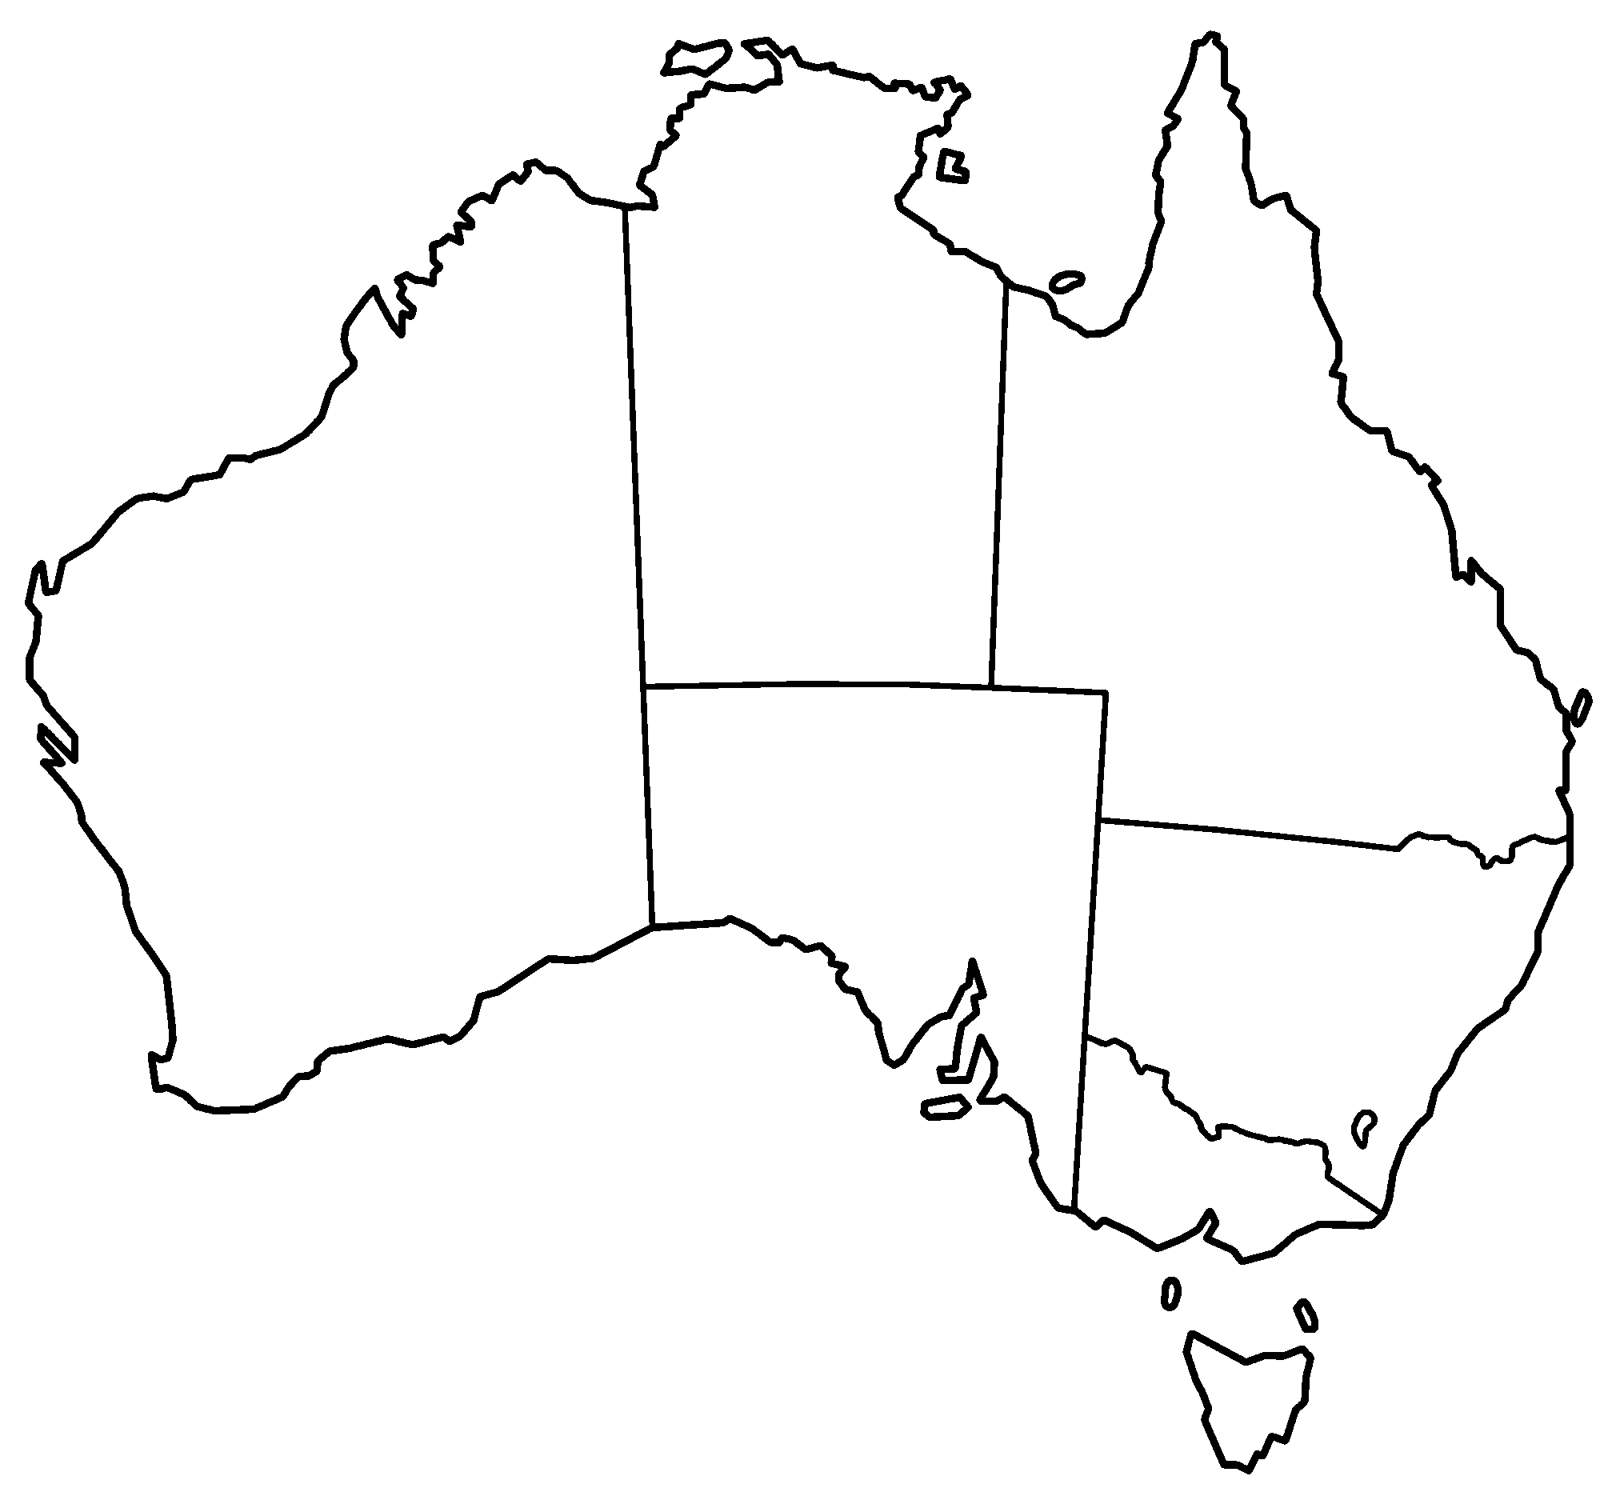

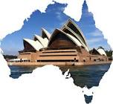
A
B
C
Northern Territory
D
Queensland
Western Australia
E
G
F
Southern Australia
New South Wales
B
Victoria
Indian Ocean (A)
Indian Ocean (B)
Coral Sea (C)
Great Barrier Reef (D)
Great Dividing Range (E)
Great Victoria Desert (F)
Uluru/Ayers Rock (G)
A
Tasmania
Land or water feature

Slide 7
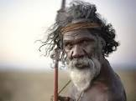
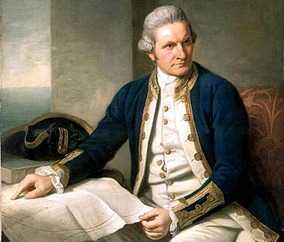
1788 – First Fleet and Convicts
The Dutch first sighted Australia in 1606 before Captain Cook colonized the land for Great Britain in 1770. The First Fleet of 11 boats arrived at Botany Bay in 1788 to establish New South Wales as a penal colony (receiving convicts until 1848). Convicts were later sent to the other states, with the exception of South Australia, which was established as a free colony in 1836.
Over 162,000 convicts were transported to Australia from Great Britain, the majority to New South Wales and Tasmania
First Nations Australian Origins
Indigenous Australians have lived in the nation for at least 50,000 years. This means they have the oldest living cultural history in the world. When the British arrived in 1788, as many as 250 different languages were spoken across the nation. Prior to the colonization of the British, there were between 300,000 and one million First Nations people living in Australia.

Slide 8
Tuesday, October 18
Standard: SS6G11 Locate selected features of Australia.
a. Locate on a world and regional political-physical map:
the Great Barrier Reef, Coral Sea, Uluru/Ayers Rock, Indian and Pacific Oceans, Great Dividing Range, and Great Victoria Desert.
Learning Target: I can locate Australia on a world map/globe and locate seven physical features of Australia.
Warm-up: Video: Australia
Work Session: Introduce Brain Wrinkles Slides and Notes. Textbook Ch.11 Section 2 (A Brief History of Australia). Create Powerpoint Study Guide.
Closing: TOD
Reminders:

Slide 9
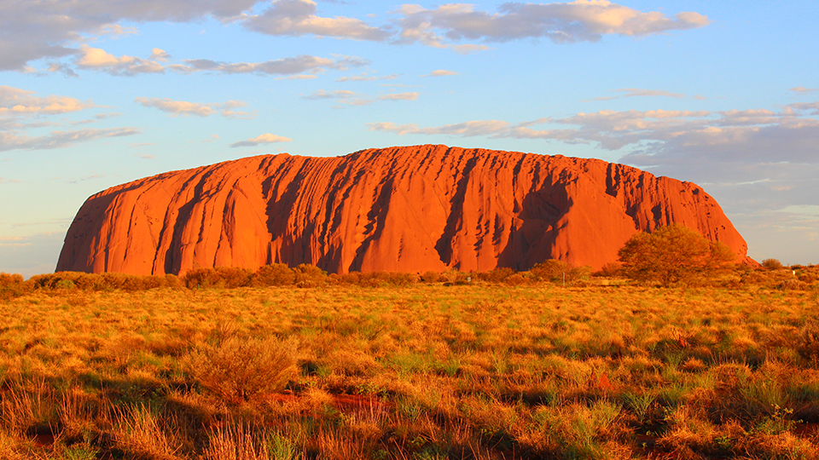
Uluru/Ayers Rock,

Slide 10
Wednesday, October 18
Standard: SS6G12 Explain the impact of location, climate, distribution of natural resources, and population distribution on Australia.
a. Describe how Australia’s location, climate, and natural resources impact trade and affect where people live. SS6G11 Locate selected features of Australia.
Learning Target: I can describe how Australia’s location, climate, and natural resources impact trade and affect where people live.
Warm-up: Video: Australia
Work Session: Brain Wrinkles Slides and Notes. Textbook Ch.11 Section 4 (Economy of Australia) Create Powerpoint Study Guide.
Graphic Organizer: Climate, Natural Resources, Trade
Closing: Summary paragraph or drawing (KWL)
Reminders:

Slide 11
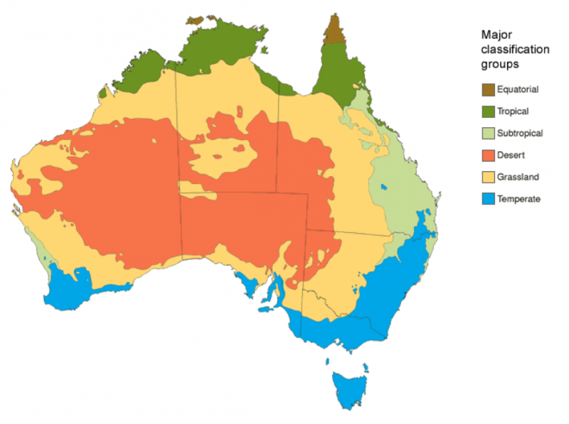

Slide 12
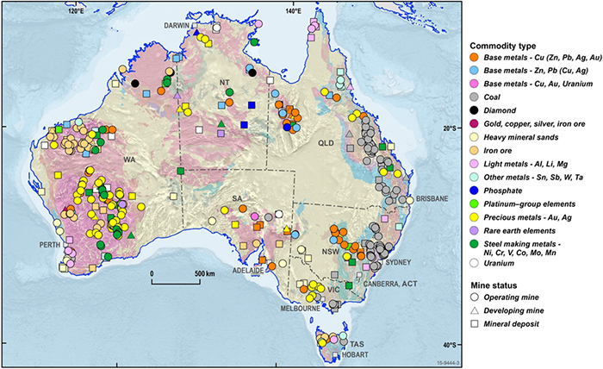
Australia is one of the world's leading producers of bauxite (aluminium ore), iron ore, lithium, gold, lead, diamond, rare earth elements, uranium, and zinc. Australia also has large mineral sand deposits of ilmenite, zircon and rutile.

Slide 13
Thursday, October 19
Standard: SS6G12 Explain the impact of location, climate, distribution of natural resources, and population distribution on Australia.
a. Describe how Australia’s location, climate, and natural resources impact trade and affect where people live. SS6G11 Locate selected features of Australia.
Learning Target: I can describe how Australia’s location, climate, and natural resources impact trade and affect where people live.
Warm-up: Video: Australia
Work Session: Brain Wrinkles Slides and Notes. Textbook Ch.11 Section 4 (Economy of Australia) Create Powerpoint Study Guide.
Graphic Organizer: Climate, Natural Resources, Trade
Closing: Think-pair- Share
Reminders:

Slide 14
Friday, October 19
Standard: SS6H4 Explain the impact of English colonization on current Aboriginal basic rights, health, literacy, and language.
SS6G12 Explain the impact of location, climate, distribution of natural resources, and population distribution on Australia.
a. Describe how Australia’s location, climate, and natural resources impact trade and affect where people live.
Learning Target: I can describe the impacts of English Colonization of Australia.
Warm-up:
Work Session: Brain Wrinkles Slides and Notes. Textbook Ch.11 Section 4 (Economy of Australia) Create Powerpoint Study Guide.
Graphic Organizer: Climate, Natural Resources, Trade
Closing: Teacher/ Students Summarize
Reminders:

Slide 15
Historical Understandings
SS6H4 Explain the impact of English colonization on current Aboriginal basic rights, health, literacy, and language.
Geographic Understandings
SS6G11 Locate selected features of Australia.
a. Locate on a world and regional political-physical map: the Great Barrier Reef, Coral Sea, Uluru/Ayers Rock, Indian and Pacific Oceans, Great Dividing Range, and Great Victoria Desert.
SS6G12 Explain the impact of location, climate, distribution of natural resources, and population distribution on Australia.
a. Describe how Australia’s location, climate, and natural resources impact trade and affect where people live.

